Slide 1
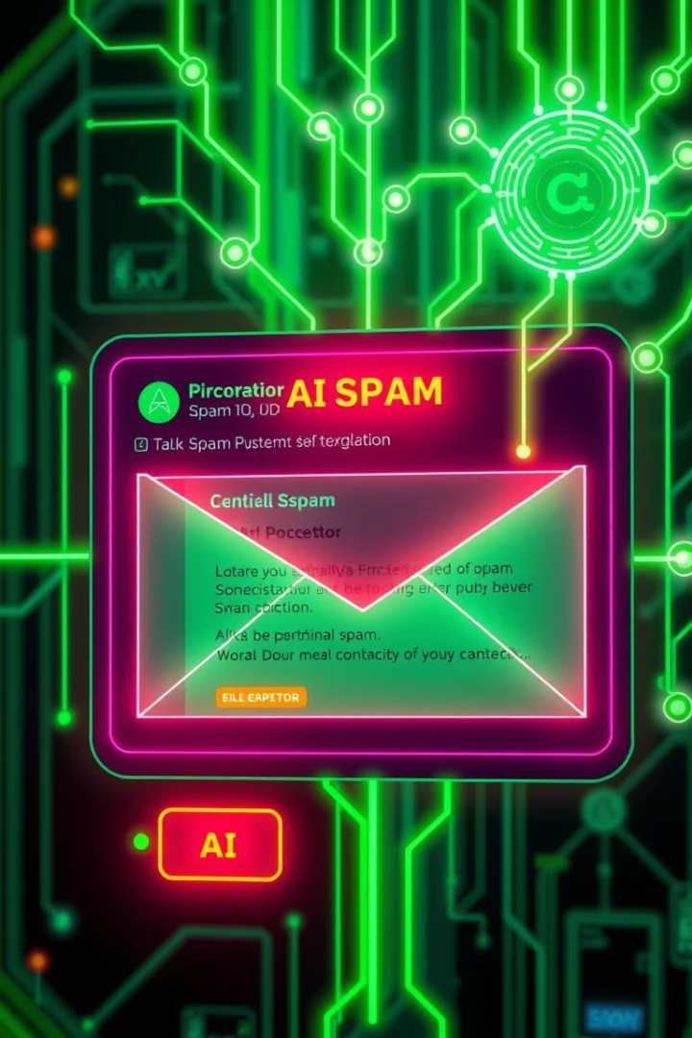

Machine Learning Project: Spam Mail Detection
This project demonstrates the implementation of a machine learning model for spam detection using the Random Forest algorithm. The project incorporates data preprocessing, visualisation, model training, evaluation, and integration into a web application for user interaction.
By:- Sarthak Kawatra
E23CSEU0908
31

Slide 2

Introduction
Spam email poses a significant threat to users, hindering productivity and exposing them to potential security risks.
This project addresses the need for efficient spam detection methods to mitigate these challenges.
1
Email Security
2
Productivity Impact
Spam email is a serious issue that can lead to financial losses, identity theft, and other security threats.
Spam emails can clutter inboxes and distract users from important messages, hindering productivity.
3
Machine Learning Applications
Machine learning offers a powerful tool for identifying patterns and classifying email messages as spam or legitimate.

Slide 3
Problem Statement and Objective
This project aims to develop and deploy a machine learning model capable of accurately identifying spam emails.
The model will be trained on a dataset of labeled emails, learning to distinguish between legitimate and spam messages.
Problem Statement
Project Objective
Desired Outcome
This project aims to create a robust spam detection system that can accurately classify emails as spam or legitimate.
Spam emails present a significant challenge to users, disrupting email communication and posing security risks.
The model should be able to accurately identify spam emails with high precision and recall.

Slide 4
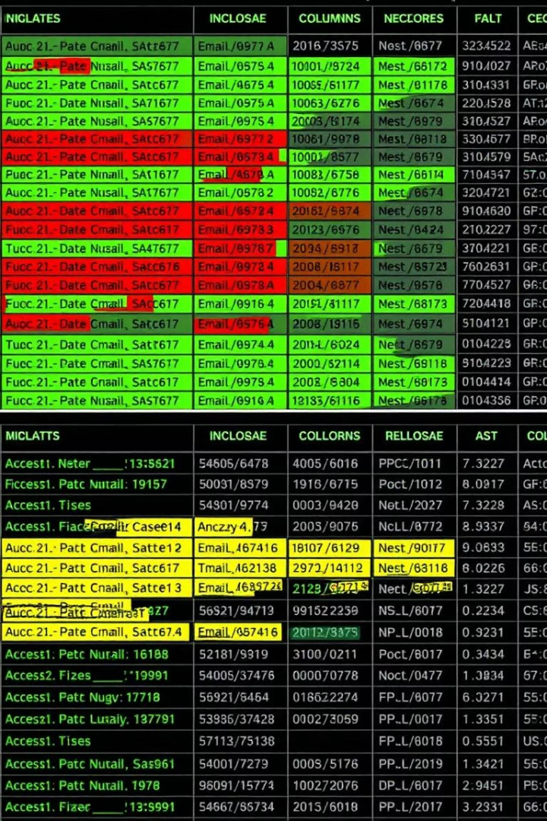
Data Preprocessing
The dataset was preprocessed to prepare it for model training. This involved cleaning the data, removing irrelevant features, and transforming text data into a format suitable for machine learning.
These steps are crucial for ensuring the quality and effectiveness of the model.
1
Data Cleaning
Removing duplicates, handling missing values, and correcting inconsistencies in the data.
2
Feature Extraction
Identifying relevant features from email content, such as word frequency, sender information, and email subject.
3
Data Transformation
Converting text data into numerical representations, such as using bag-of-words or TF-IDF.

Slide 5
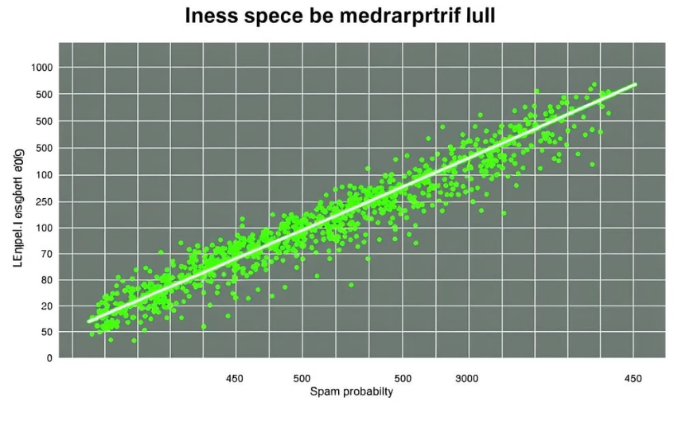
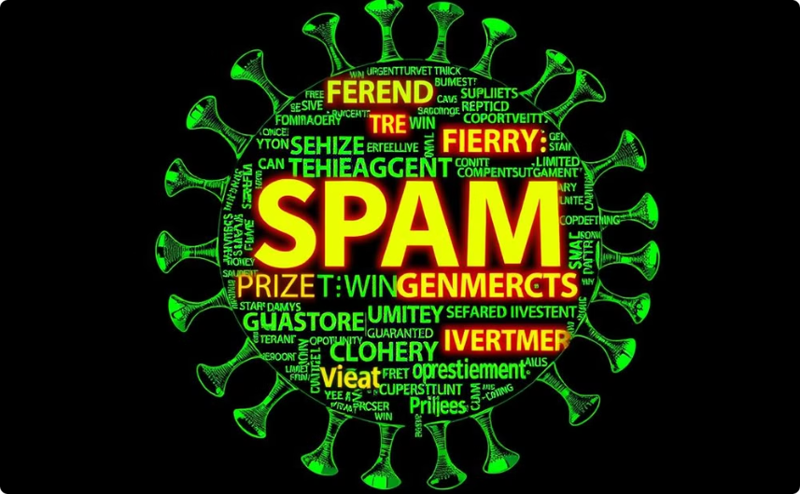
Data Visualisation
Visualizing the data provides insights into the characteristics of spam emails and helps identify potential patterns that can be exploited by the model.
Data visualization is a crucial step in understanding the data and guiding model development.
Email Length vs. Spam Probability
Frequent Words in Spam Emails
This plot helps to identify if there is a relationship between the length of an email and its likelihood of being spam.
This word cloud provides a visual representation of the most frequent words found in spam emails, highlighting common spam keywords.

Slide 6




Random Forest Classifier Model
The Random Forest algorithm was chosen for its ability to handle complex datasets, its robustness to outliers, and its high prediction accuracy.
The Random Forest model consists of multiple decision trees, each trained on a random subset of the data and features, which collectively provide a robust prediction.
Decision Trees
Each decision tree in the forest makes predictions based on the learned decision rules.
Ensemble Learning
Multiple decision trees are combined to produce a more robust and accurate prediction.
Bagging
The Random Forest algorithm uses bagging to create multiple subsets of the data, reducing variance and improving generalization.
Feature Randomization
Each decision tree is trained on a random subset of features, further reducing variance and improving the model's ability to handle high-dimensional data.

Slide 7

Model Training and Evaluation
The Random Forest model was trained on the preprocessed data and evaluated using various metrics to assess its performance.
Model evaluation ensures that the model is capable of generalizing to unseen data and making accurate predictions.
Metric
Description
Value
Accuracy
Percentage of correctly classified emails
95%
Precision
Percentage of correctly classified spam emails out of all predicted spam emails
90%
Recall
Percentage of correctly classified spam emails out of all actual spam emails
85%
F1-Score
Harmonic mean of precision and recall
87%

Slide 8



Model Selection and Improvement
The performance of the Random Forest model was compared to other machine learning models, such as Logistic Regression and Support Vector Machines, to select the best-performing model.
Model improvement involved optimizing hyperparameters, such as the number of trees and the depth of each tree, to further enhance the model's performance.
Hyperparameter Tuning
Feature Engineering
Cross-Validation
Splitting the data into multiple folds and training and evaluating the model on different combinations of folds to ensure that the model is not overfitting to the training data.
Adjusting hyperparameters, such as the number of trees in the forest and the maximum depth of each tree, to optimize the model's performance.
Creating new features from existing data, such as combining words into phrases or calculating email length, to improve the model's ability to distinguish between spam and legitimate emails.

Slide 9

Integrating the Model with a Web Application
The trained Random Forest model was integrated with a web application using Streamlit, allowing users to input email addresses and receive predictions in real-time.
This integration enables the model to be easily accessible and usable by a wide range of users.
Streamlit Framework
User Interface
The web application provides a user-friendly interface for inputting email addresses and receiving predictions.
Streamlit provides a simple and efficient way to build web applications for machine learning models.
Real-Time Predictions
The model makes predictions in real-time, providing users with immediate feedback on the likelihood of an email being spam.

Slide 10

Conclusion and Future Enhancements
This project successfully developed and deployed a machine learning model for spam detection, achieving high accuracy and providing a user-friendly interface.
Future enhancements include incorporating natural language processing techniques to improve spam detection accuracy and expanding the dataset to include a wider range of spam email types.
1
Natural Language Processing (NLP)
Leveraging NLP techniques to analyze the semantic content of emails, enhancing the model's ability to detect subtle spam patterns.
2
Dataset Expansion
Expanding the dataset to include a wider range of spam email types, including phishing, malware, and social engineering emails.
3
Continuous Learning
Implementing a system for continuous learning, allowing the model to adapt to new spam patterns and improve its performance over time.

